Slide 1
Reliable Insurance
You are safe in our hands!

Slide 2
Reliable Insurance – Why choose us?
Highest number of in-network healthcare providers.
Lowest copay in industry.
Less than 5 clicks to register, easy for even 5th grader to register!
24/7 customer care.
Customer is almost always right in other cases execute recursively!

Slide 3

We cover everything except…

Slide 4
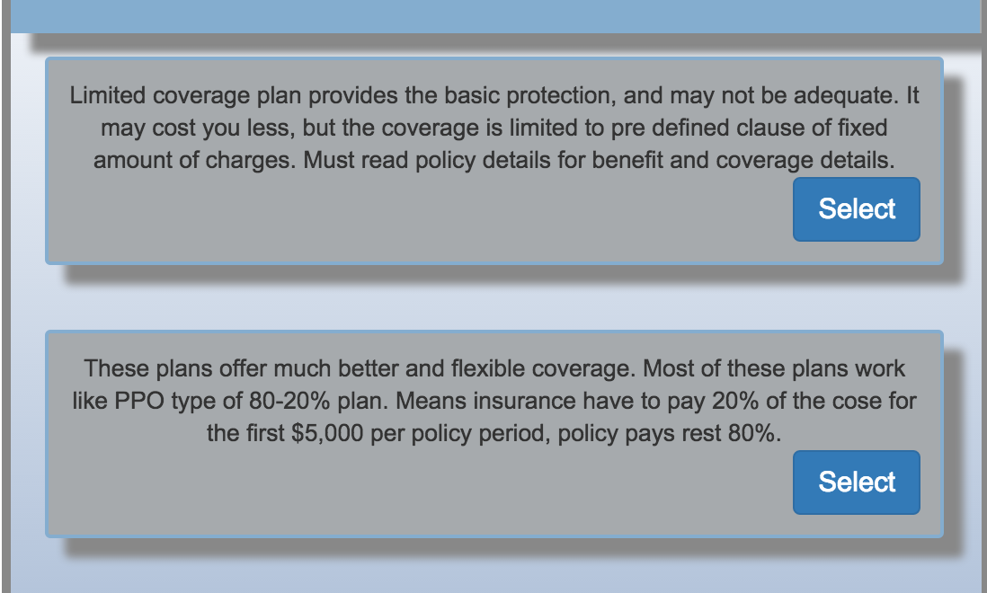
Limited Coverage or Comprehensive?

Slide 5
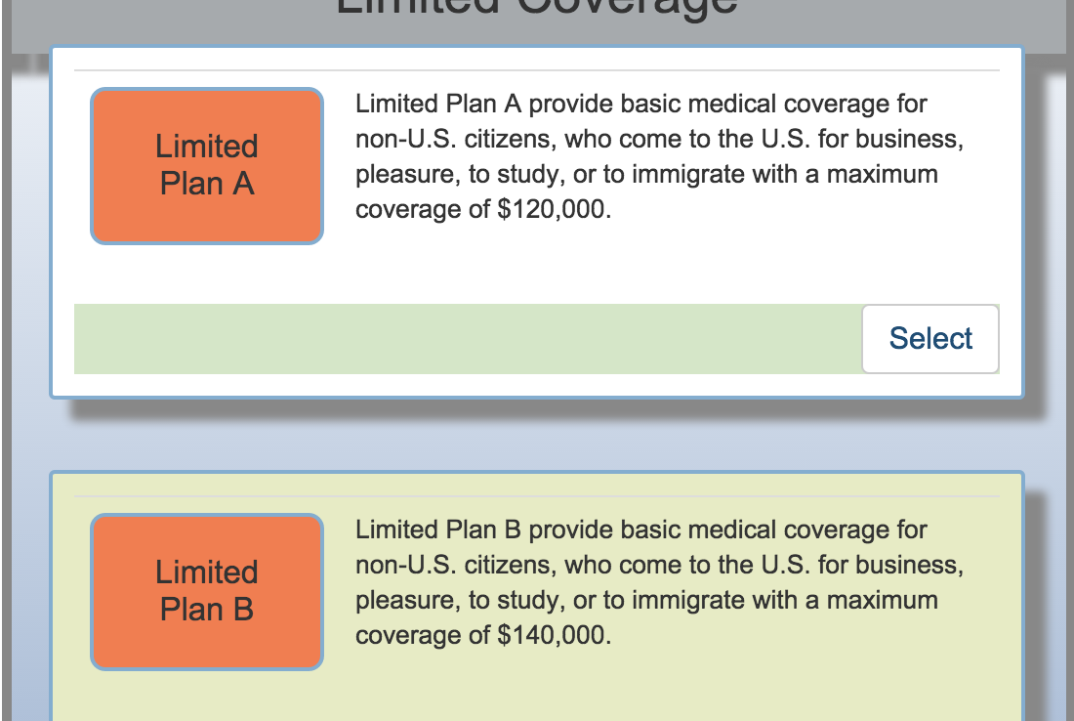
Select your limited Coverage

Slide 6
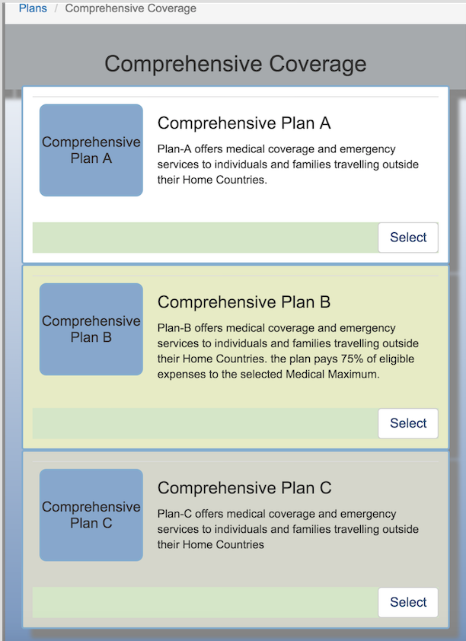
Select your comprehensive coverage

Slide 7
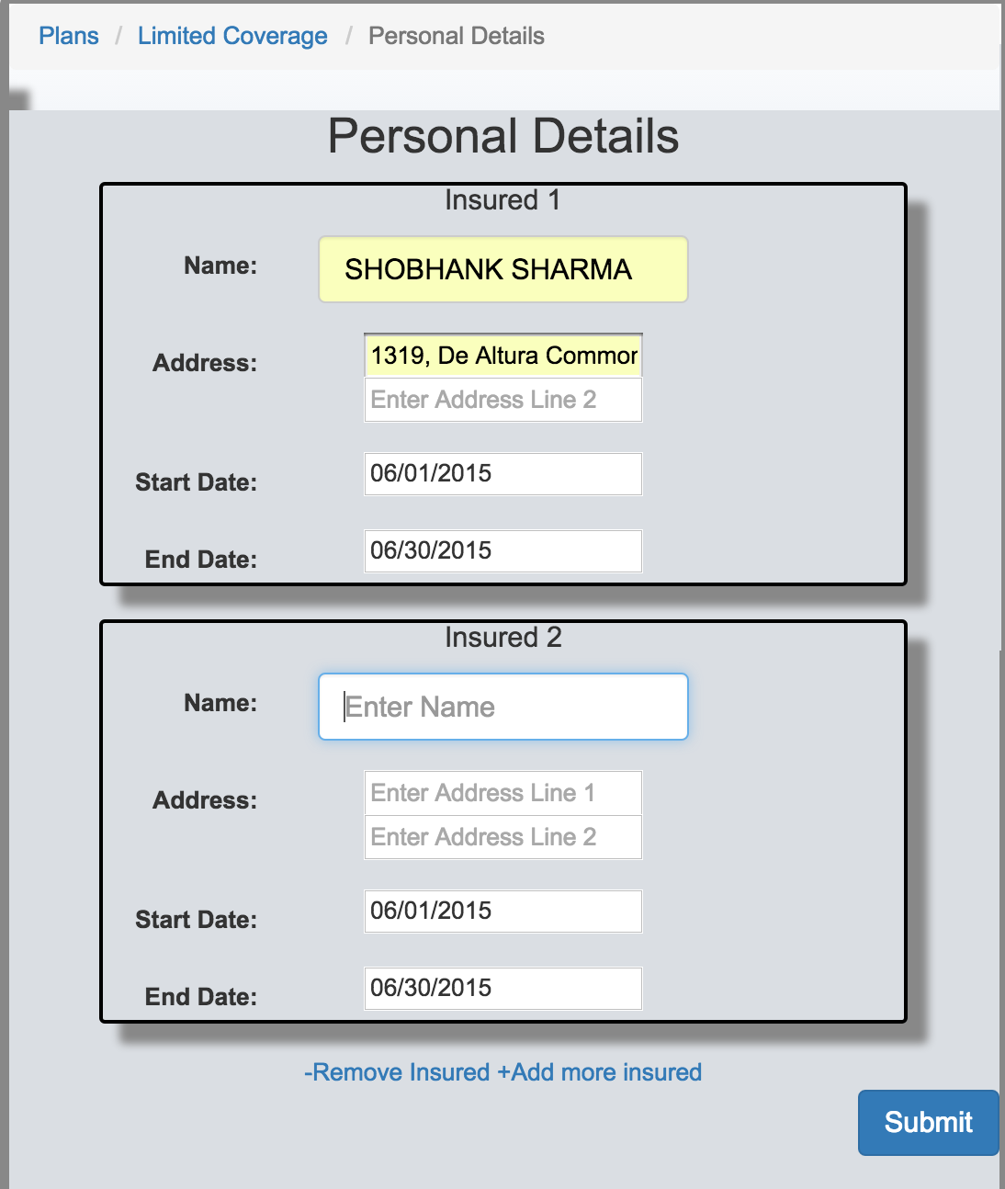
Tell us about yourself and your family members

Slide 8
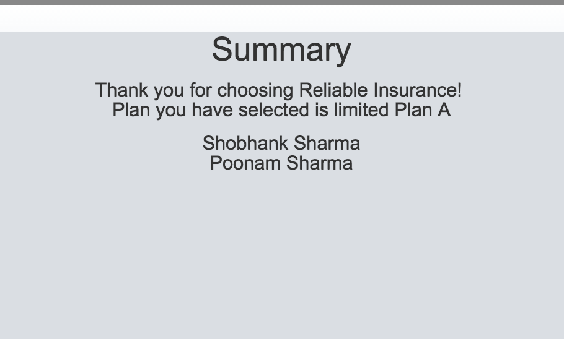
And you have ticket to good health!!!

Slide 9
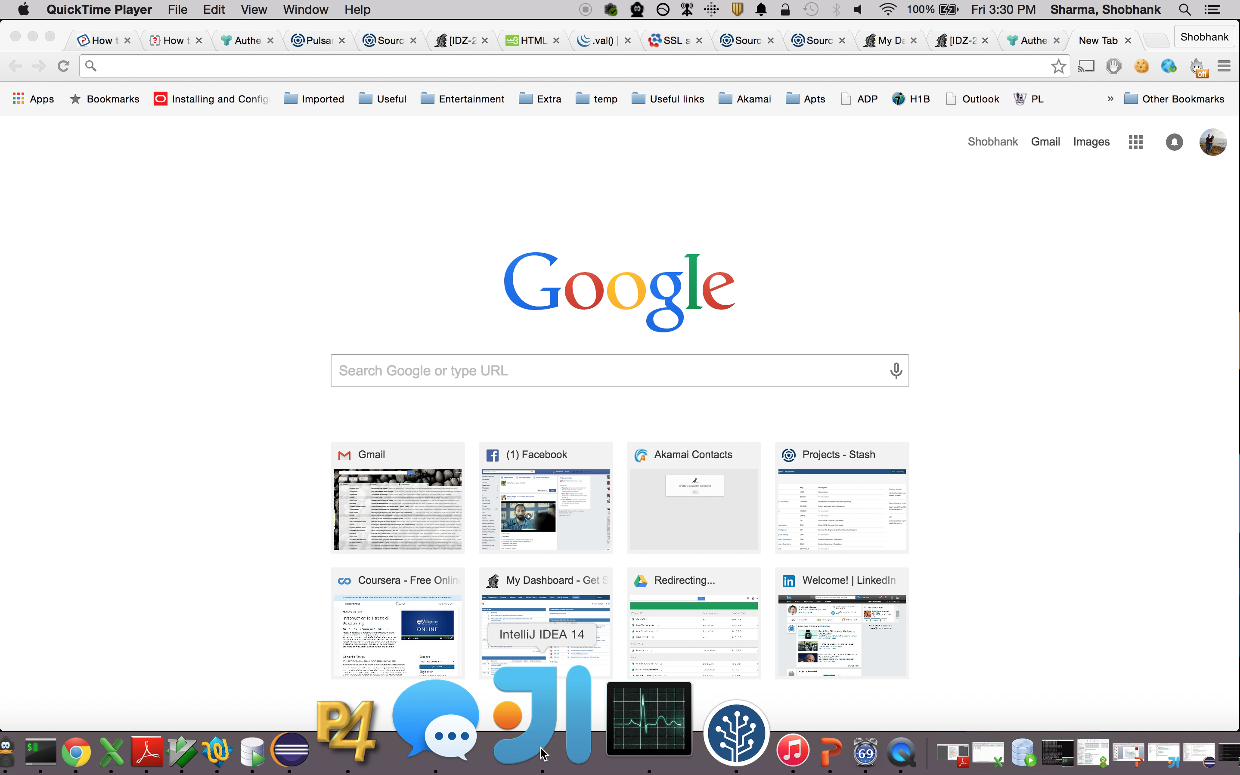
Demo Time! Live demos are vulnerable, hence I have recorded one!

Slide 10
Thank you!
Question? Comments?
Clone/Fork/Checkout at
https://bitbucket.org/shobhanks/insurance-app
Email at shobhanks1987@gmail.com
Connect me on Linkedin
https://www.linkedin.com/pub/shobhank-sharma/1b/8a2/497

